Slide 1
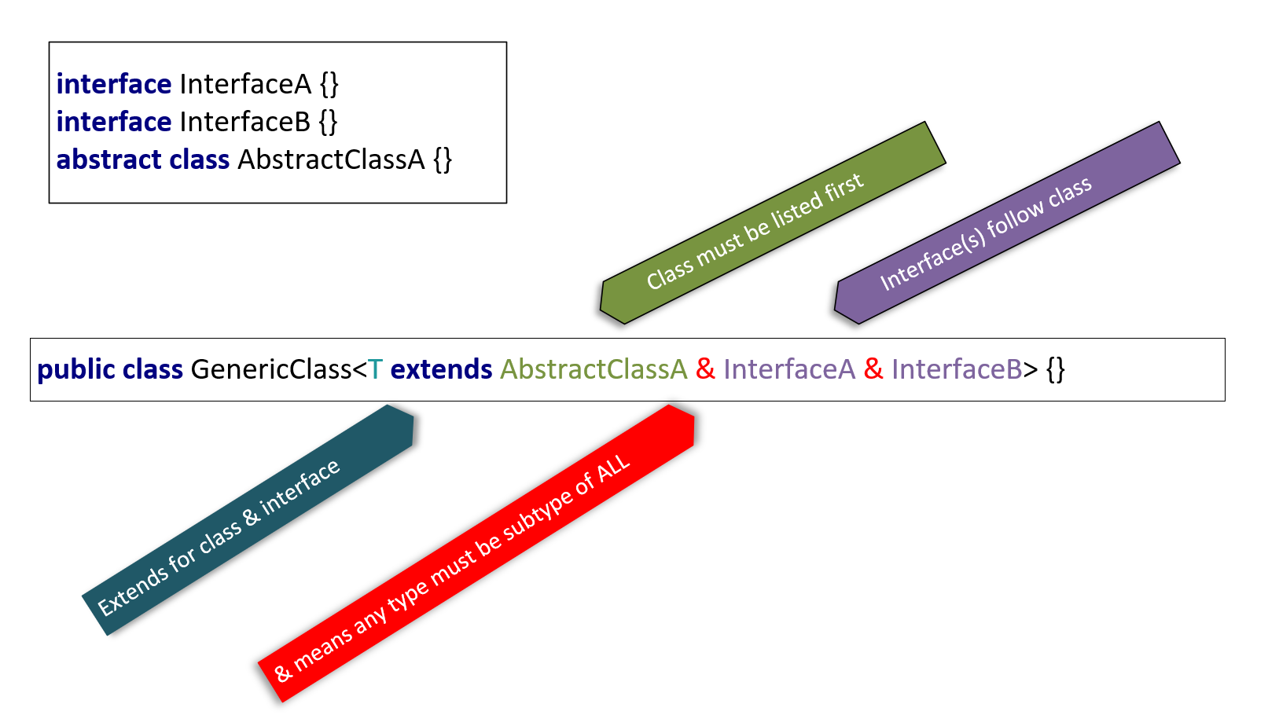

Using Multiple types to declare an Upper Bound
You can use multiple types to set a more restrictive upper bound, with the use of an ampersand between types.
The conditions require a type argument, to implement all interfaces declared, and to be a subtype of any class specified.
You can extend only one class at most, and zero to many interfaces.
You use extends for either a class or an interface or both.
If you do extend a class as well as an interface or two, the class must be the first type listed.
COMPLETE JAVA MASTERCLASS
Static methods & multiple upper bounds

